Slide 1


RELIABILITY ANALYSIS IN DIGITAL CIRCUITS
Mentor :
Dr.Pushpa Raikwal
Presented by:
B. Rakesh(20BEC026)
B. Sharath Naik(20BEC028)
R. Narahari(20BEC088)
V S S Sainath Sanapala(20BME061)

Slide 2
INTRODUCTION
RELIABILITY PARAMETERS
Lifetime Reliability is a significant concern
with downscaling of CMOS technology.
There are many phenomenon that degrades the circuit performance.
As time passes and temperature vary, these phenomenon come into effect
We study the effects and propose a efficient circuit which performs well.
TIME DELAY
Time delay is defined as the time taken to a signal to propagate through the input to output. For a circuit to be more reliable, it should have the least time delay.
LEAKAGE CURRENT
Leakage current is the current that flows through the circuit even when it is in off state. It can also be defined as off state current of a circuit. Leakage current should be less for a circuit to be more reliable.
CRITICAL CHARGE
Critical charge is the minimum amount of charge that must be deposited by a particle strike to cause a circuit to malfunction. More the critical charge more is the circuit reliability

Slide 3
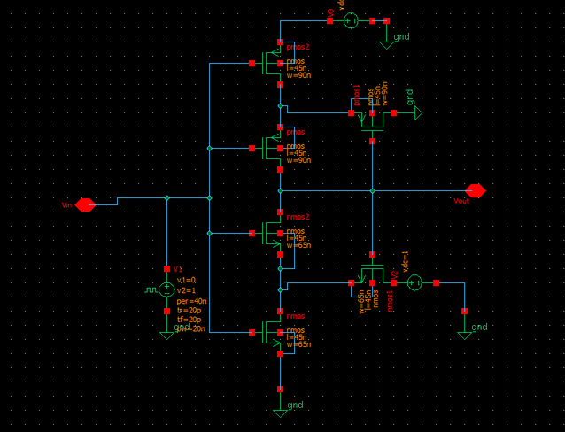
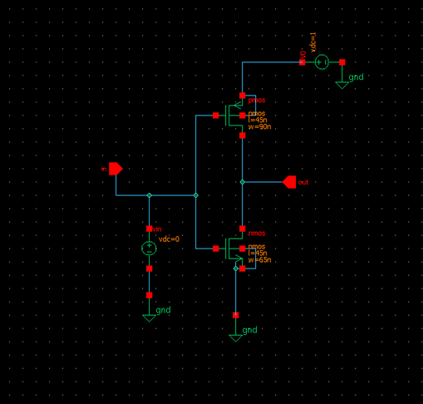
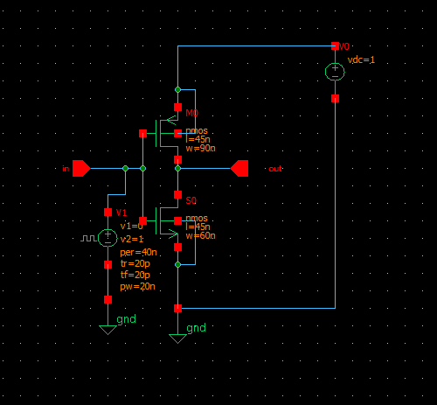
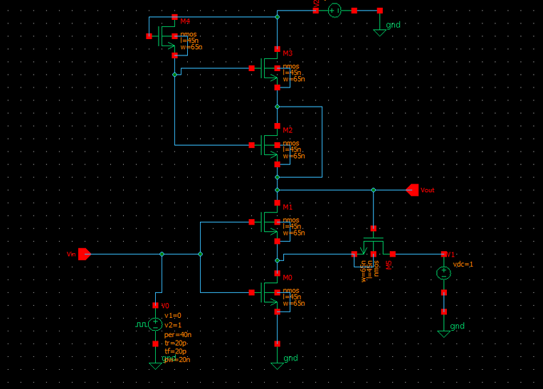
CIRCUIT DIAGRAMS
SCHMITT TRIGGER
CMOS INVERTER
VOLTAGE BOOTSTRAPPING SCHMITT TRIGGER
FINFET BASED INVERTER

Slide 4


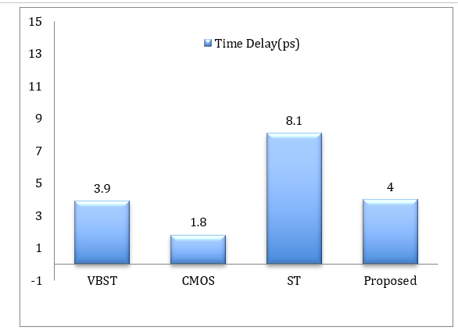
Time Delay Comparison Graph

Slide 5
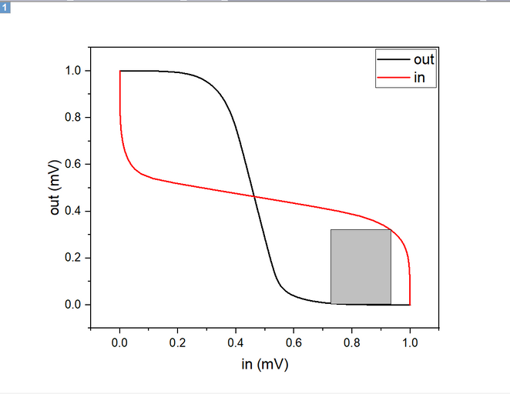
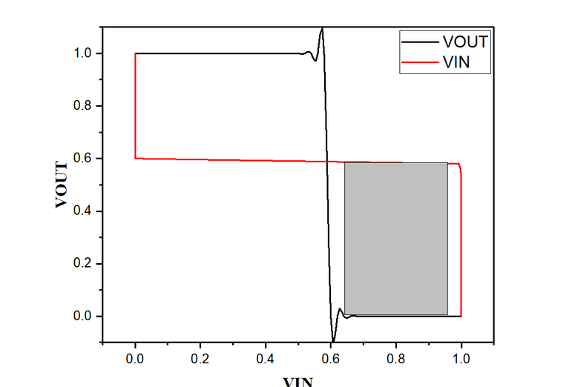
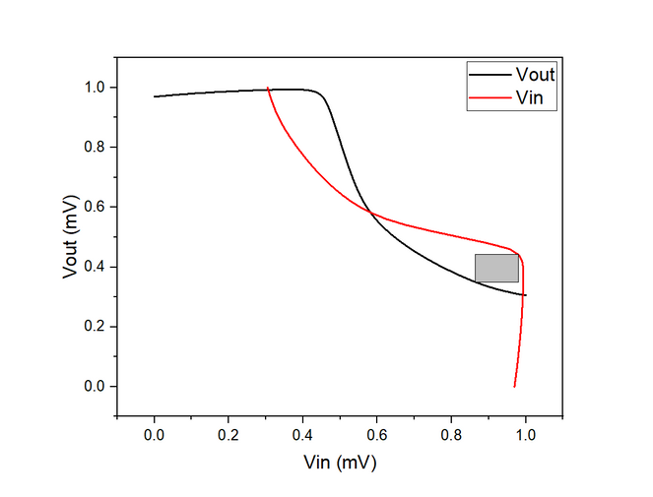
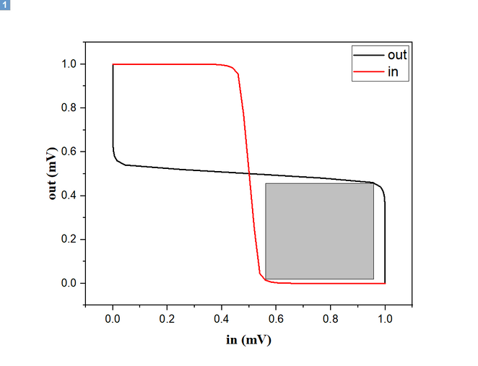
STATIC NOISE MARGIN(SNM)
CMOS Inverter
Schmitt Trigger
VBST
FinFET based Inverter

Slide 6
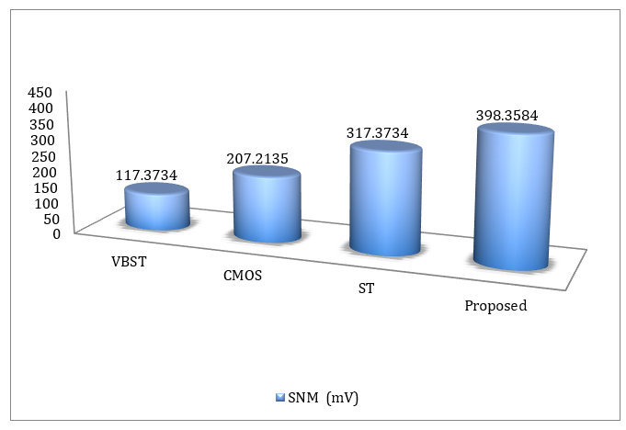
Static Noise Margin(SNM) comparison

Slide 7
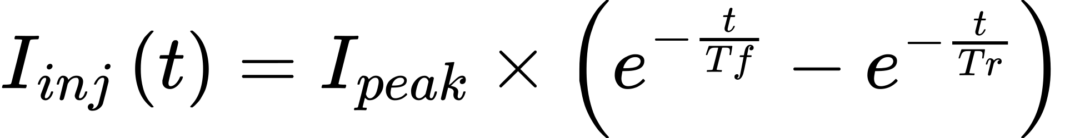
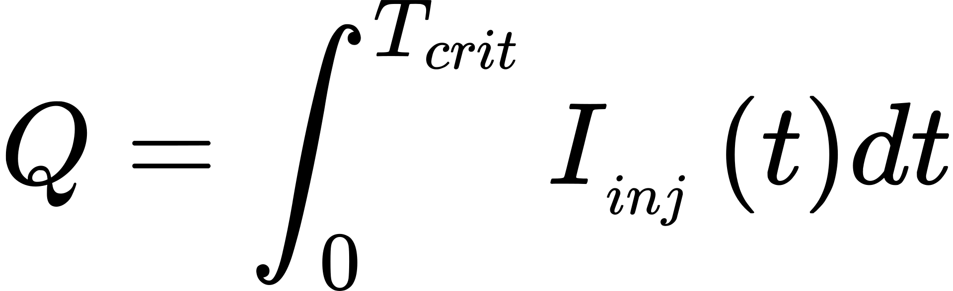
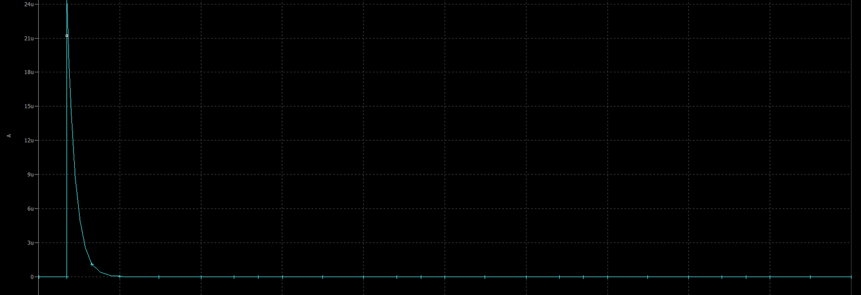
Critical Charge
Tr = Rise Time, Tf = Fall Time

Slide 8
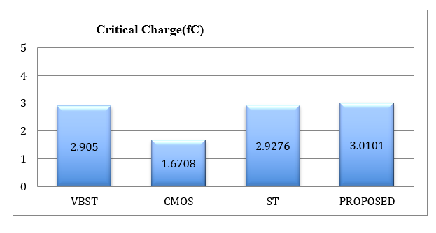
Critical Charge comparison

Slide 9
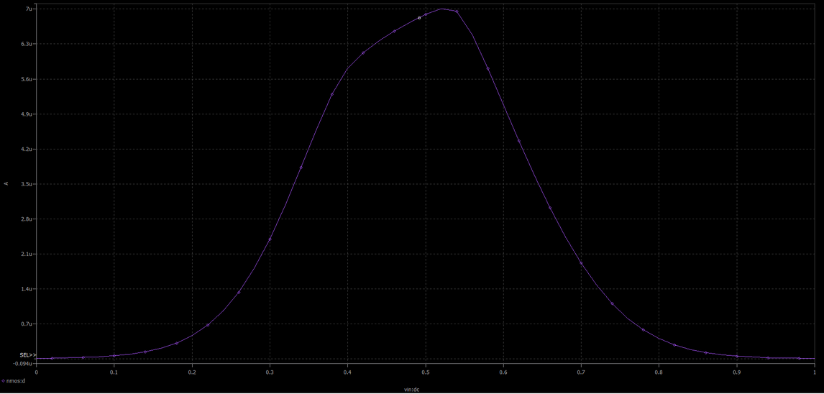
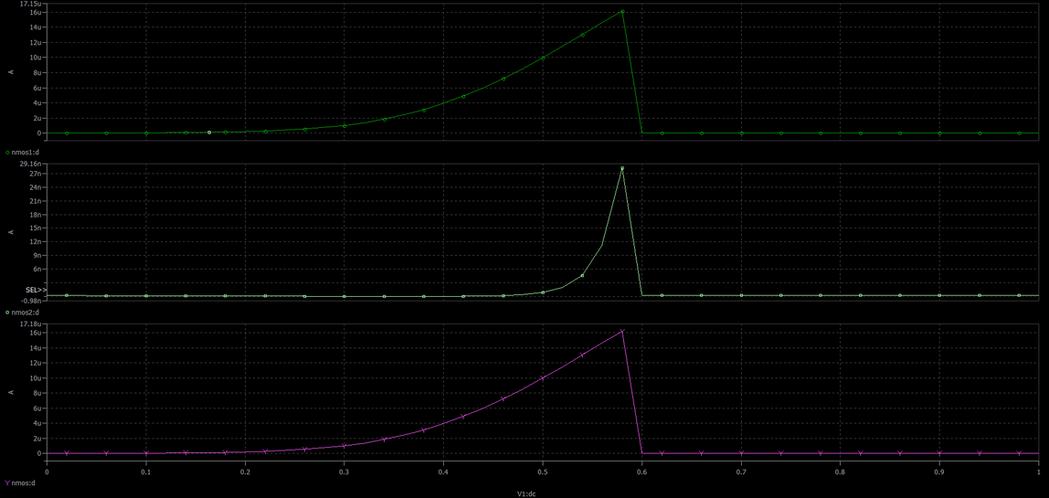
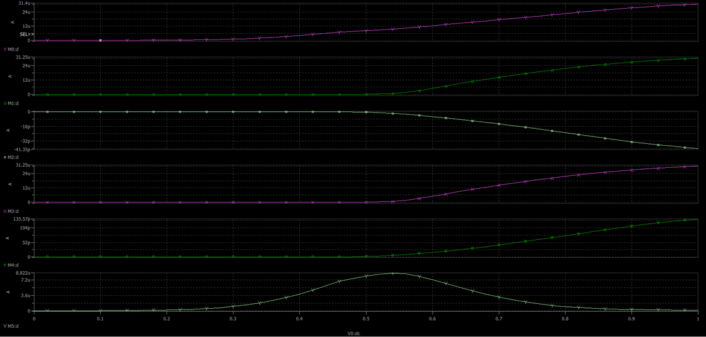
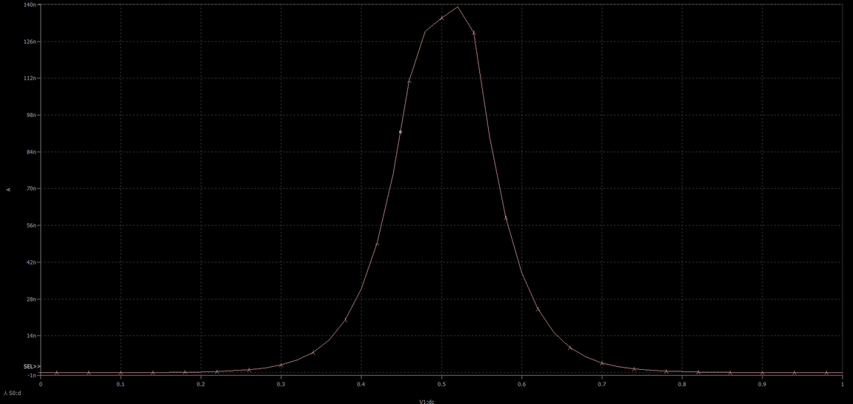
Leakage Current
CMOS Inverter
Schmitt Trigger(ST)
Voltage BootstrappingSchmitt trigger(VBST)
Voltage Bootstrapping Schmitt Trigger(VBST)
FinFET based Inverter

Slide 10
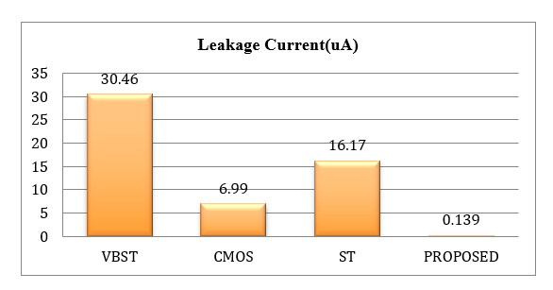
Leakage Current Comparison Graph

Slide 11
Conclusion:
 | CMOS INVERTER | SCHMITT TRIGGER | VOLTAGE BOOTSTRAPPING SCHMITT TRIGGER | FinFET based Inverter
Time Delay(ps) | 1.8 | 8.1 | 1.1 | 4
SNM(mV) | 207.2135 | 317.3734 | 117.3734 | 398.3584
Critical Charge(fC) | 1.6708 | 2.9276 | 2.9050 | 3.0101
Leakage Current(uA) | 6.99 | 16.17 | 30.46 | 0.139

Slide 12
References:
Neha Gupta, A P Shah, R S Kumar, Gopal Raut, Soft error hardened voltage bootstrapped Schmmit trigger design for reliable circuits, microelectronics reliability
2. Sumio Tanaka, Theory of drain leakage current in silicon MOSFETs
3. Critical charge, Architecture Design for soft errors

Slide 13
THANK YOU

